Slide 1
What Variables Contribute to Poor Mental and Physical Health?
Sam Largaespada & Tyler Johnson

Slide 2
Importance
Mental Health and Physical Health have many contributing elements, but some are clearly more important or have a greater effect on it than others
Improving people’s physical and mental health is probably a good thing for society in general

Slide 3
Goals
Use PCA to combine original dimensions into more generalized factors
Use SEM to find an equation that can adequately describe variables leading to poor mental and physical health

Slide 4
Population and Sample
Our data came from the General Social Survey (GSS)
Our sample population was Americans who took the GSS in the year 2022
The GSS is conducted every 2 years by the National Opinion Research Center (NORC)
It seeks to get opinions about a wide range of topics including demographic information, political views, personal health, and many others
It is conducted in-person by NORC and uses area probability methodology to ensures its participants come from urban, suburban, and rural areas

Slide 5
Retained Variables
We chose the original dimensions based mainly on our opinions about what could most significantly affect mental health
Predictors:
Marital Happiness
Life Satisfaction
Condition of Health
Socioeconomic Index
Financial Satisfaction
Job Satisfaction
Job Interference with Family Life
Hours Worked/Week
Political Views
Height
Weight
Response:
Poor Mental Health Days in the last 30 days
Poor Physical Health Days in the last 30 days

Slide 6
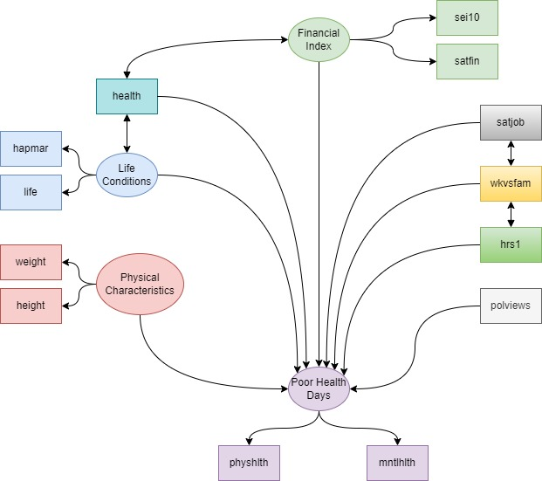
Path Diagram

Slide 7
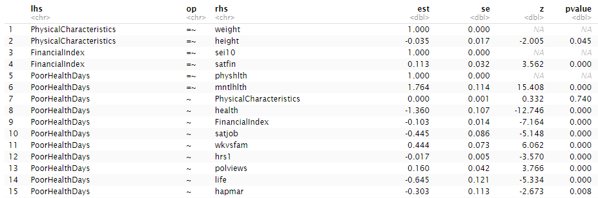
SEM output

Slide 8
Results
We found that all of our included dimensions and factors were significantly associated with PoorHealthDays aside from PhysicalCharacteristics, which was a factor describing Height and Weight
We found the strongest effect on PoorHealthDays was Health (meaning the recipients opinion on their own health)
As a respondent's opinion about their own health increased (got better), PoorHealthDays decreased
This seems obvious in hindsight, but it was interesting to see how strong the effect was.
The strongest positive effect on PoorHealthDays was wkvsfam
This means that as a respondent’s job interfered with there family life, PoorHealthDays tended to increase

Slide 9
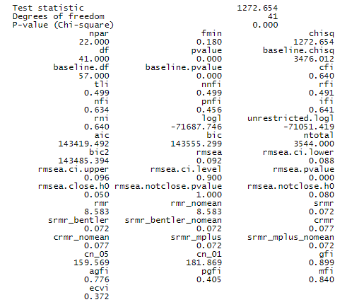
Validity of Results
Unfortunately, our Fit Indices did not find our reconstructed covariance structure to be adequately similar to the original
Our best index was GFI at 0.899, just below the common threshold of 0.9
RMSEA was at 0.092, which is approaching the common threshold of 0.08

Slide 10
Significance
Assuming that our model is actually valid, it provides some interesting insights into the type of variables that lead to better or worse health outcomes.
The impact of social variables such as work vs family conflicts and marital happiness were actually quite powerful indicators of mental and physical health.
Financial variables like socioeconomic index and financial satisfaction had weaker effects than I would have assumed, though job satisfaction did have quite a large impact

